Slide 1

2022 KIDA Indoor Guard
& Percussion Show
Saturday, March 5, 2022
Information Pack
3471 Campus Drive
Ijamsville, MD 21754
GPS: 39.327366,-77.340108

Slide 2
Urbana Contacts
Mike Harrison, Band Director Michael.Harrison@fcps.org
(410) 353-6907
Jane Price, Urbana Band Boosters President
jane.price1@comcast.net
(240)-367-4162
Official and Final Schedule is available on the KIDA website

Slide 3
FCPS COVID Policy
Effective, February 25, 2022, a face covering is no longer required to be worn by individuals while inside FCPS buildings, but still encouraged.
It is recommended that participants/spectators remain physically distant to the extent possible.
Directors from outside of FCPS are encouraged to continue to follow their own school’s guidelines as they see fit

Slide 4
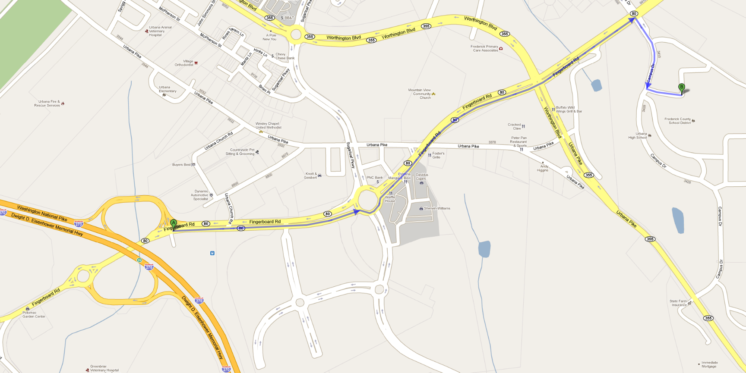
Getting There
From I-270 north, take exit 26 and turn left onto Fingerboard Road (Rt. 80).
From I-270 south, take exit 26 and turn right onto Fingerboard Road.
Drive 1 mile on Fingerboard Road, and turn right onto Campus Drive.
Participants take 2nd left to unload and park. Spectators take 4th or 5th left.
Urbana High
School

Slide 5
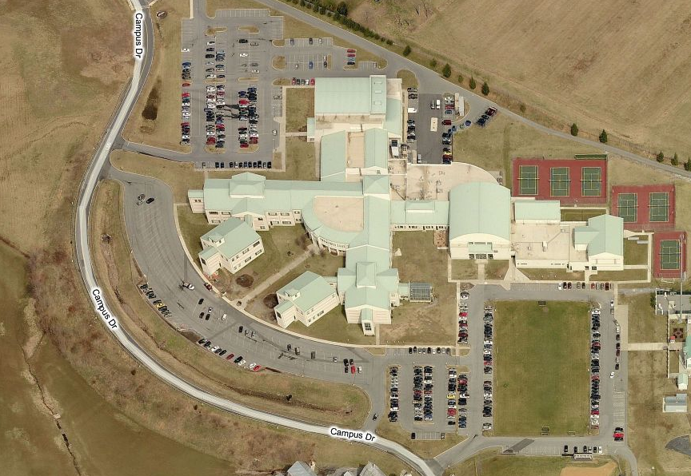

Arrival
ALL Units
Check in
HERE!
Participants
Entrance
Auditorium
Gym
Spectator
Only Entrance
Spectator
Parking Entrances

Slide 6
Parking
Truck/Crew Parking
Truck Loading Zone
ONLY!
No parking
Participant
Entrance
Drop off only
Auditorium
Check in
Handicapped
Parking
Gym
Bus Parking
Spectator Overflow
Spectator Entrance
Spectator
Parking Entrances

Slide 7
Interior Flow
Dressing rooms are available to get into costume.
Percussion units will warm up in rooms A, B, or C.
For guard, body warm-up is in room A (band room) or B (chorus room) and equipment warm-up is in the auxiliary gym, room C or D.
Hosts will escort units.
Housing Area (Auditorium)
Dress
rooms
Participant
Check in
restrooms
Loading Dock
Props and Instruments Unload & Load
Warm-up
Room A
Concessions
Warm-up
Room B
H
restrooms
Prop Storage
Performance
Area
+
Warm-up
Room
C
------------
D
restrooms
Spectator Entrance
+
First Aid
H
Hospitality

Slide 8
Unit Flow Detail
Participant
Exit Only
Spectator
Entrance & Exit
Spectators
Students
Vertical Center Line
Judges
ONLY
Power outlet
Spectators
Participant
Entrance
Women’s
Restrooms
Men’s

Slide 9
In planning your visit to
Urbana High School
The show starts at 3:00 PM. Spectator doors will open at 2:00 PM Check-in begins at 1:00 PM.
CHECK-IN is at the AUDITORIUM entrance. Groups arriving at the Gym must return to vehicles and drive over to check-in.
Please be sure we know the names of your directors/key personnel to ease check-in.
Check-in will be easier if your unit arrives all together at the same time. If this is not feasible, please make sure that the first arrival has sufficient information for check-in.
Determine how many chaperones, pit crew, and support staff will be attending. Per KIDA guidelines, we will provide 10 passes per unit. If you need more than 10, you may purchase of additional passes at check-in.
Only participants and their support staff may travel between the housing, warm-up and performance areas
Will you fit? The smallest door you will travel through with percussion equipment is 55” by 80” and with props is 66” by 80”. Please allow 1½” clearance from the floor.
Use of a floor covering is preferred.
Floor loading and unloading will be a vertical center line with entrance and exit into the performance space on opposite sides of the gym.
Concessions will be available starting at noon.
Please follow the directions of the staff during the loading and unloading of equipment. Our goal is to manage units as quickly as possible.
Thank you so much for participating!

Slide 10
When you arrive
All units, support staff and pit crews check in at the Auditorium entrance. Please do not go to the Gymnasium.
Please wait in your vehicles to be greeted and receive unloading and parking instructions.
Please try to keep vehicles together as a group for check-in.
Equipment Drivers need to check in and await directions before proceeding to the unloading area.
Check-in will begin at 1:00 PM. (Concessions open at 2:00 PM.)
Sound checks will occur in breaks. Please be ready. LABEL EVERYTHING with group and class. If you have a disk, make sure it is not CD-RW.

Slide 11
Check-in
UHS Staff will greet you and complete check-in where wrist bands will be distributed.
A host will be assigned to your unit and stay with you to answer questions, help keep you on schedule, and guide you around the building.
Everyone, except drivers, will unload personal belongings and proceed into the Auditorium which will be the Housing area.
Students needed to assist in unloading equipment will be directed to the unloading area from the Auditorium once personal items are stored and vehicle is at the ramp for unloading.
All equipment and props will be unloaded and moved to a holding area closer to the Gym until warm-up and performance.

Slide 12
During your Visit
Please follow all rules and school regulations to help ensure a smooth day for everyone.
Units will be housed in the auditorium prior to warm-up. Only Water is allowed in the auditorium.
Please refrain from using restrooms in Auditorium lobby for changing.
Dressing rooms are available for changing. Inform us at check-in if your unit needs to use the changing rooms.
All units are asked to be supervised by their adult chaperones and to try to move as a group.
Directors and Staff are invited to stop by the Hospitality Room.
Free wandering throughout the school is not permitted. There are other activities at the school this day.
No playing instruments or spinning equipment outside of scheduled warm-up rooms and times.
No wandering looking for additional warm up areas. All units will be given plenty of time in warm up areas for stretching and warm up.
All food and drinks must be consumed in the cafeteria. Water, consumed with care, is okay in warm-up areas if in re-sealable containers.
Please let us know where we can assist you to make your visit enjoyable.

Slide 13
For Warm-ups
Your host will lead you to pick up your equipment and to your warm-up area.
Bring everything you need from the housing area to warm-up.
Spinning of guard equipment is only permitted in Warm-up Rooms C and D (auxiliary gym).
Equipment warm up for guards will be in the auxiliary gym. The gym will be split into C and D, with each group getting half of the gym for warm up.
Please follow directions so that we can keep to the schedule and keep Units moving easily through the building.

Slide 14
After Performance
We ask that you move as a group to return to the housing areas.
If there is sufficient time to load trucks and trailers before the awards, this is encouraged.
We encourage units to return as a group between the Auditorium and the Gym/Cafeteria.
Only Unit Staff and Chaperones should accompany group back to holding area. Spectators will not be permitted beyond the Performance and Concessions area.

Slide 15
Before you Leave
Check with Staff in loading dock area before pulling up trucks for loading.
Please check for all belongings. Lost and Found will be at the Check-in desk.
Please make sure your unit’s "housing area" in auditorium is clean.
Make sure to let us know if you had a good time and what we can do better for next year.

Slide 16
Please Share with your
Families and Supporters
The Gym entrance (as well as concessions) opens at 2:00 PM for Spectators.
Regular Tickets are $10 each. Student and Senior Citizen Tickets are $8 each.
We will have a wonderful selection of lunch, dinner and snack selections, along with home baked sweets for sale.
Fun tee-shirts and band jewelry is for sale, too
Flower, Candy, and Air Grams will be available for purchase.

Slide 17





CONCESSIONS
Open at 2pm
Pork BBQ
BBQ Fries
Chicken Tenders
Pizza
Burgers
Hot Dogs
Nachos
Milkshakes
And more!!!

